Slide 1


Harshit Verma
April 20, 2024

Slide 2

Outline
Executive Summary
Introduction
Methodology
Results
Conclusion
Appendix

Slide 3
Executive Summary
In this project, a complete set of different data science methodologies were employed to study the historical launch data of SpaceX using Falcon9 rockets. Data were collected through public SpaceX API and web scraping from the SpaceX Wikipedia page. After preprocessing the collected data, exploratory data analysis was employed using magic SQL commands and various visualization libraries in Python to understand the data better. After gathering relevant columns to be used as features for predictive model development, various classification models were developed and tested for optimal results based on their respective accuracy scores.
Four machine learning models were produced: Logistic Regression, Support Vector Machine, Decision Tree Classifier, and K Nearest Neighbors. All produced similar results with an accuracy rate of about 83.33%. All models over-predicted successful landings. More data is needed for better model determination and accuracy.

Slide 4
Introduction
SpaceX advertises Falcon 9 rocket launches on its website at a cost of 62 million dollars; other providers cost upward of 165 million dollars each, and much of the savings is because SpaceX can reuse the first stage.
Therefore, if we can determine if the first stage will land, we can determine the cost of a launch. This information can be used if SpaceY wants to bid against SpaceX for a rocket launch.

Slide 5

Section 1

Slide 6
Methodology
Executive Summary
Data collection methodology:
Data Collection through SpaceX public API and web scraping of the SpaceX Wikipedia page
Perform data wrangling
Classifying true landings as successful and unsuccessful otherwise
Perform exploratory data analysis (EDA) using visualization and SQL
Perform interactive visual analytics using Folium and Plotly Dash
Perform predictive analysis using classification models
Tuned models using GridSearchCV

Slide 7
Data Collection
The data collection process involved a combination of API requests from Space X's public API and web scraping data from a table in Space X’s Wikipedia entry.
The following slide will show the flowchart of data collection from API, and the one after will show the flowchart of data collection from web scraping.
SpaceX API Data Columns:
FlightNumber, Date, BoosterVersion, PayloadMass, Orbit, LaunchSite, Outcome, Flights, GridFins, Reused, Legs, LandingPad, Block, ReusedCount, Serial, Longitude, Latitude
Wikipedia Webscrape Data Columns:
Flight No., Launch site, Payload, PayloadMass, Orbit, Customer, Launch outcome, Version Booster, Booster landing, Date, Time

Slide 8
Data Collection – SpaceX API
Request and parse the SpaceX launch data using the GET requests
Filter the data frame to only include Falcon 9 launches
Replace the missing values of Payload Mass with mean of all other records
Exporting the data frame to a csv file for further analysis
GitHub URL:
https://github.com/Harshit-Optimus0089/IBM_Data_Science_Capstone/blob/b6c0c33f19176419bbc743a953fa5f3e96eaa048/jupyter-labs-spacex-data-collection-api.ipynb

Slide 9
Data Collection - Scraping
Request the Falcon9 Launch Wiki page from its URL
Extract all column/variable names from the HTML table header
Create a data frame by parsing the launch HTML tables
Export the data frame to a csv file for further analysis
GitHub URL:
https://github.com/Harshit-Optimus0089/IBM_Data_Science_Capstone/blob/b6c0c33f19176419bbc743a953fa5f3e96eaa048/jupyter-labs-webscraping.ipynb

Slide 10
Data Wrangling
Create a training label with landing outcomes where successful = 1 & failure = 0.
The Outcome column has two components: ‘Mission Outcome’ and ‘Landing Location’
New training label column ‘class’ with a value of 1 if ‘Mission Outcome’ is True and 0 otherwise.
Value Mapping:
True ASDS, True RTLS, & True Ocean – set to -> 1
None None, False ASDS, None ASDS, False Ocean, False RTLS – set to -> 0
GitHub URL:
https://github.com/Harshit-Optimus0089/IBM_Data_Science_Capstone/blob/b6c0c33f19176419bbc743a953fa5f3e96eaa048/labs-jupyter-spacex-Data%20wrangling.ipynb

Slide 11
EDA with Data Visualization
Exploratory Data Analysis was performed on variables such as flight number, payload mass, launch site, orbit, class, and year.
Plots Used:
Flight Number vs. Payload Mass, Flight Number vs. Launch Site, Payload Mass vs. Launch Site, Orbit vs. Success Rate, Flight Number vs. Orbit, Payload vs Orbit, and Success Yearly Trend
Scatter plots, line charts, and bar plots were used to compare relationships between variables to decide if a relationship exists so that they could be used in training the machine learning model.
GitHub URL:
https://github.com/Harshit-Optimus0089/IBM_Data_Science_Capstone/blob/b6c0c33f19176419bbc743a953fa5f3e96eaa048/edadataviz.ipynb

Slide 12
EDA with SQL
Loaded data set into IBM DB2 Database using sqlite3 library.
Queried using SQL Python integration.
Queries were made to get a better understanding of the dataset.
Queried information about launch site names, mission outcomes, various payload sizes of customers and booster versions, and landing outcomes.
GitHub URL:
https://github.com/Harshit-Optimus0089/IBM_Data_Science_Capstone/blob/b6c0c33f19176419bbc743a953fa5f3e96eaa048/jupyter-labs-eda-sql-coursera_sqllite.ipynb

Slide 13
Build an Interactive Map with Folium
Folium maps mark launch sites, successful and unsuccessful landings, and a proximity example to crucial locations, such as railway, highway, coast, city, etc.
This allows us to understand why launch sites may be located where they are. Also visualizes successful landings relative to location.
GitHub URL:
https://github.com/Harshit-Optimus0089/IBM_Data_Science_Capstone/blob/b6c0c33f19176419bbc743a953fa5f3e96eaa048/lab_jupyter_launch_site_location.ipynb

Slide 14
Build a Dashboard with Plotly Dash
Dashboard includes a pie chart and a scatter plot.
A pie chart can be selected to show the distribution of successful landings across all launch sites and can be selected to show individual launch site success rates.
Scatter plot takes two inputs: All sites or individual sites and payload mass on a slider between 0 and 10000 kg.
The pie chart is used to visualize the launch site success rate.
The scatter plot can help us see how success varies across launch sites, payload mass, and booster version categories.
GitHub URL:
https://github.com/Harshit-Optimus0089/IBM_Data_Science_Capstone/blob/d0f11f6cd0fa3c388c48797c4cb9e443890ff712/spacex_dash_app.py

Slide 15
Predictive Analysis (Classification)
Split the label column “Class” from the dataset
Standardize the features using StandardScaler and fit_transform them.
Split the data into Training and Testing sets using train_test_split
Use Classification Models namely: LogReg, SVM, Decision Tree and KNN
Score models on split test set
Perform Cross Validation using GridSearchCV with CV = 10 to find optimal parameters
Plot confusion Matrix for all Models
Compare the Models
GitHub URL:
https://github.com/Harshit-Optimus0089/IBM_Data_Science_Capstone/blob/d0f11f6cd0fa3c388c48797c4cb9e443890ff712/SpaceX_Machine%20Learning%20Prediction_Part_5.ipynb

Slide 16
Results
Exploratory data analysis results
Interactive analytics demo in screenshots
Predictive analysis results

Slide 17

Section 2

Slide 18
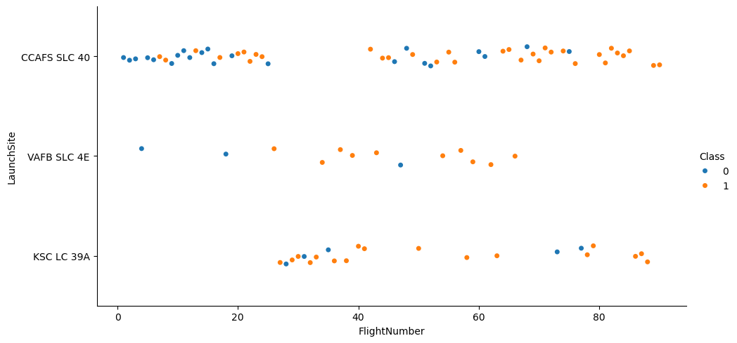
Flight Number vs. Launch Site
The orange indicates a successful launch and the blue indicates a failed launch
Graphic suggests an increase in success rate over time.
The success rate significantly increased after 20 flights, which shows the technology readiness threshold.
CCAFS appears to be the main launch site, with the most volume.

Slide 19
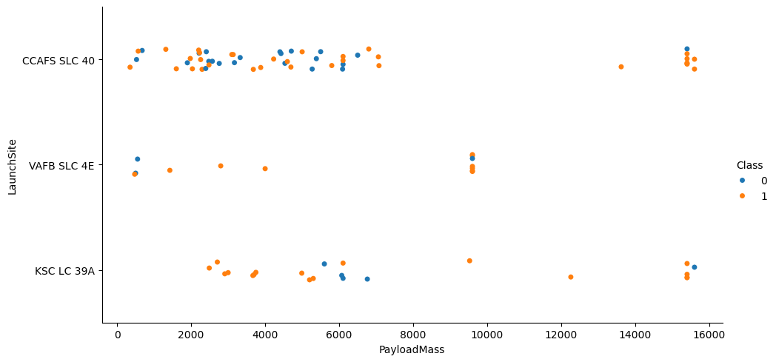
Payload vs. Launch Site
The orange indicates a successful launch and the blue indicates a failed launch
Payload mass appears to fall mostly between 0-6000 kg.
Different launch sites also seem to be used for different payload mass

Slide 20
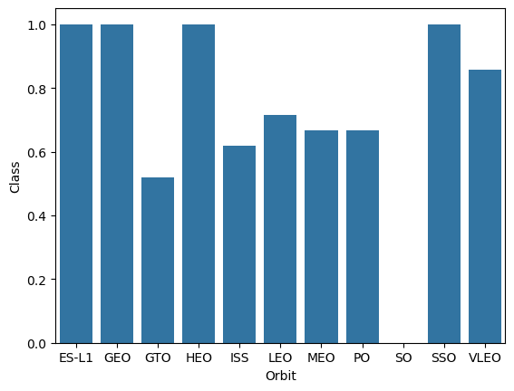
Success Rate vs. Orbit Type
Success Rate Scale with
0 as 0%
0.6 as 60%
1 as 100%
ES-L1 (1), GEO (1), and HEO (1) have a 100% success rate (sample sizes in parenthesis), and SSO (5) has a 100% success rate.
VLEO (14) has a decent success rate and attempts.
SO (1) has 0% success rate
GTO (27) has around a 50% success rate but the largest sample.

Slide 21
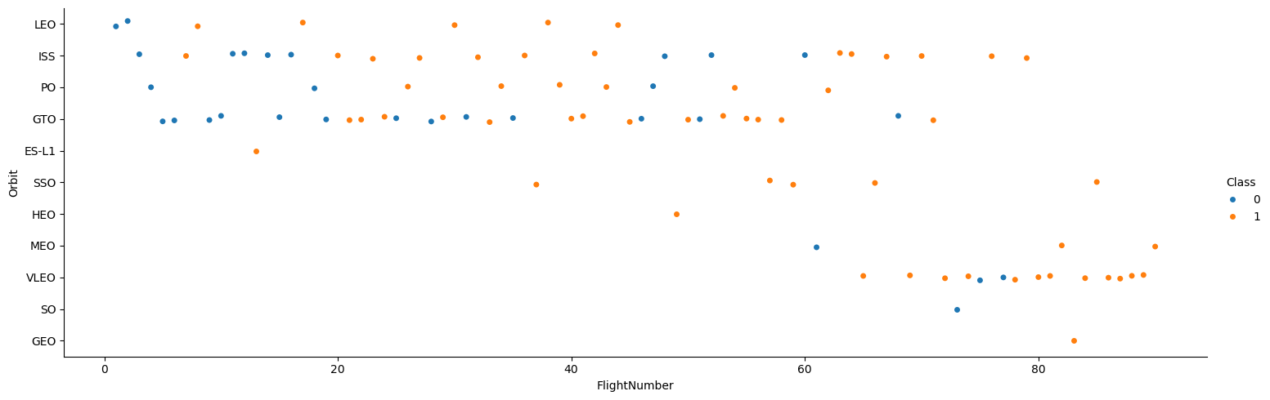
Flight Number vs. Orbit Type
The orange indicates a successful launch and the blue indicates a failed launch
Launch Orbit preferences changed over Flight Number.
Launch Outcome seems to correlate with this preference.
SpaceX started with LEO orbits which saw moderate success LEO and returned to VLEO in recent launches
SpaceX appears to perform better in lower orbits or Sun-synchronous orbits

Slide 22
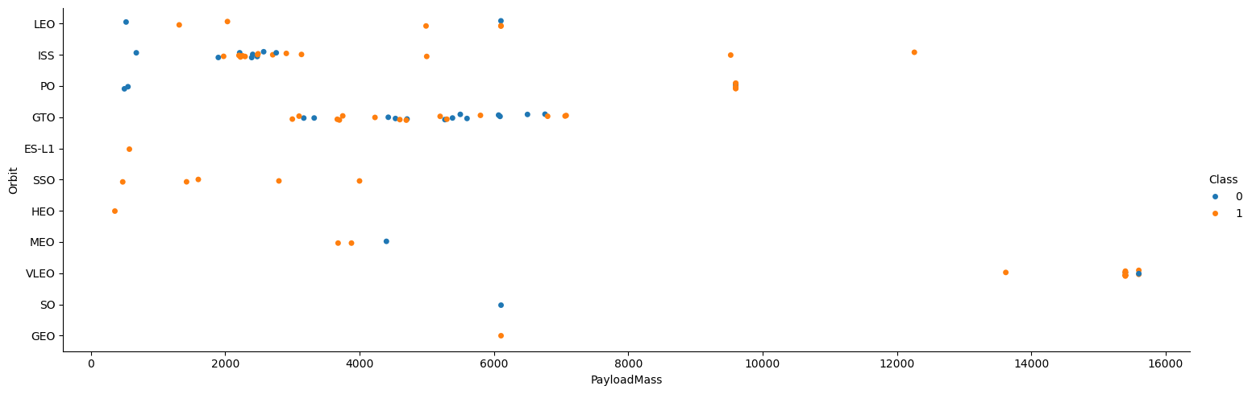
Payload vs. Orbit Type
The orange indicates a successful launch and the blue indicates a failed launch
Payload mass seems to correlate with orbit
LEO and SSO seem to have relatively low payload mass
The other most successful orbit VLEO only has payload mass values in the higher end of the range

Slide 23
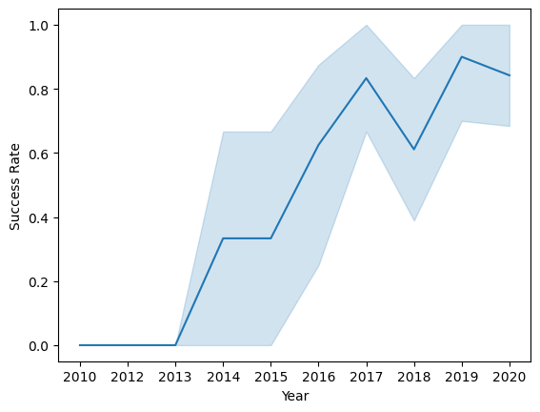
Launch Success Yearly Trend
95% confidence interval (light blue shading)
Success generally increased over time since 2013 with a slight dip in 2018
Success in recent years at around 80%

Slide 24
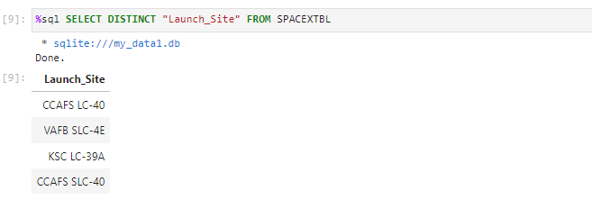
All Launch Site Names
Query unique launch site names from the database.
CCAFS SLC-40 and CCAFS LC-40 likely all represent the same launch site with data entry errors.
CCAFS LC-40 was the previous name. Likely only 3 unique launch site values: CCAFS SLC-40, KSC LC-39A, VAFB SLC-4E

Slide 25
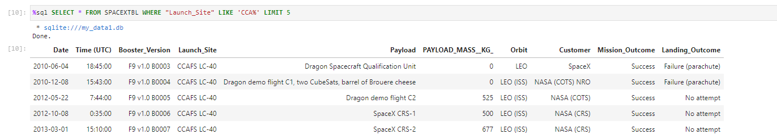
Launch Site Names Begin with 'CCA'

Slide 26
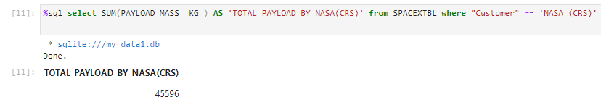
Total Payload Mass
This query sums the total payload mass in kg where NASA was the customer.
CRS stands for Commercial Resupply Services, which indicates that these payloads were sent to the International Space Station (ISS).

Slide 27
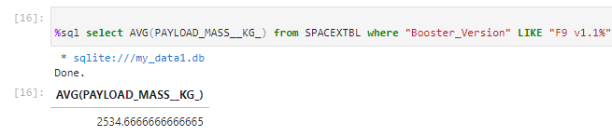
Average Payload Mass by F9 v1.1
This query calculates the average payload mass or launches which used booster version F9 v1.1
Average payload mass of F9 1.1 is on the low end of our payload mass range

Slide 28
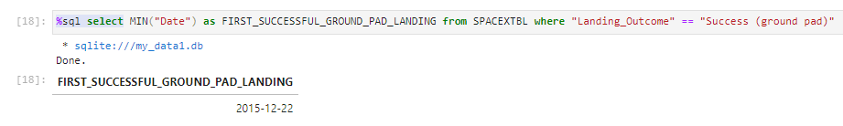
First Successful Ground Landing Date
This query returns the first successful ground pad landing date.
The first ground pad landing wasn’t until the end of 2015.
Successful landings, in general, appear starting in 2014.

Slide 29
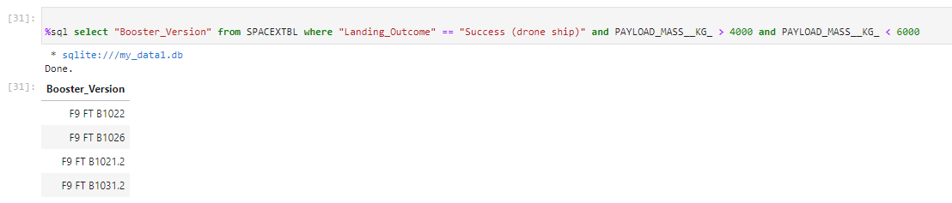
Successful Drone Ship Landing with Payload between 4000 and 6000
This query returns the four booster versions with successful drone ship landings and a payload mass between 4000 and 6000 non - inclusive.

Slide 30
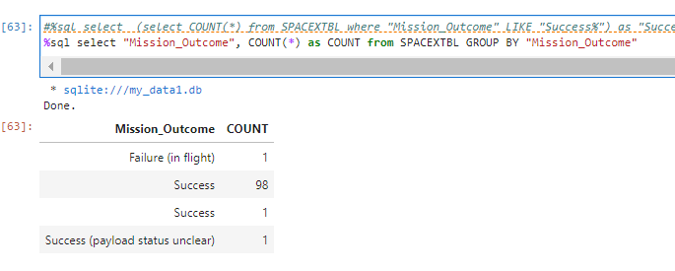
Total Number of Successful and Failure Mission Outcomes
This query returns a count of each mission outcome.
SpaceX appears to achieve its mission outcome nearly 99% of the time.
This means that most of the landing failures are intended.
Interestingly, one launch has an unclear payload status; unfortunately, one failed in flight.

Slide 31
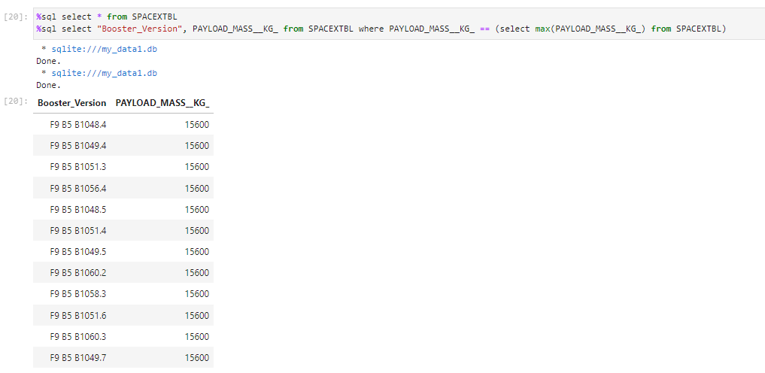
Boosters Carried Maximum Payload
This query returns the booster versions that carried the highest payload mass of 15600 kg.
These booster versions are very similar, and all are of the F9 B5 B10xx.x variety.
This likely indicates that payload mass correlates with the booster version that is used.

Slide 32
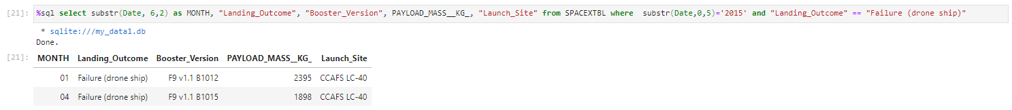
2015 Failed Drone Ship Landing Records
This query returns the Month, Landing Outcome, Booster Version, Payload Mass (kg), and Launch site of 2015 launches where stage 1 failed to land on a drone ship.
There were two such occurrences.

Slide 33
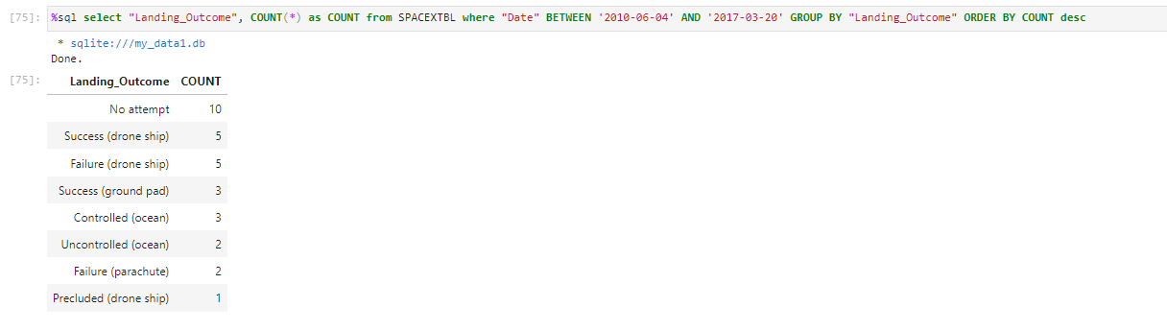
Rank Landing Outcomes Between 2010-06-04 and 2017-03-20
This query returns a list of successful landings between 2010-06-04 and 2017-03-20 inclusively.
There are two types of successful landing outcomes: drone ship and ground pad landings.
There were 8 successful landings in total during this time period

Slide 34

Section 3

Slide 35
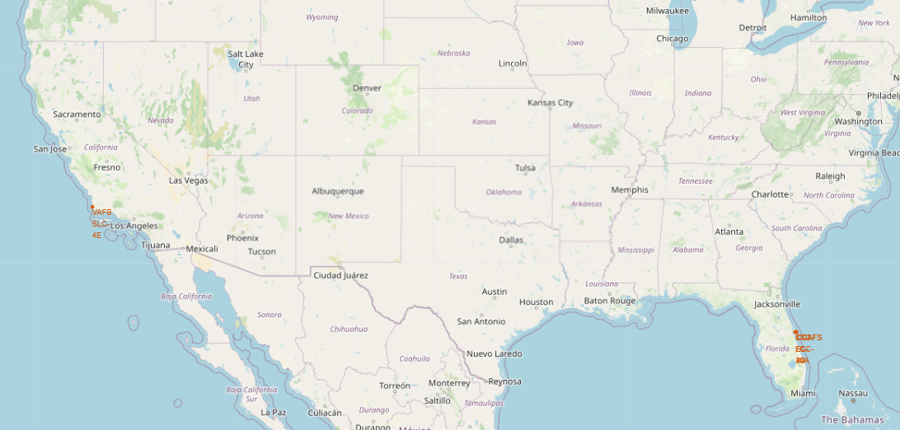
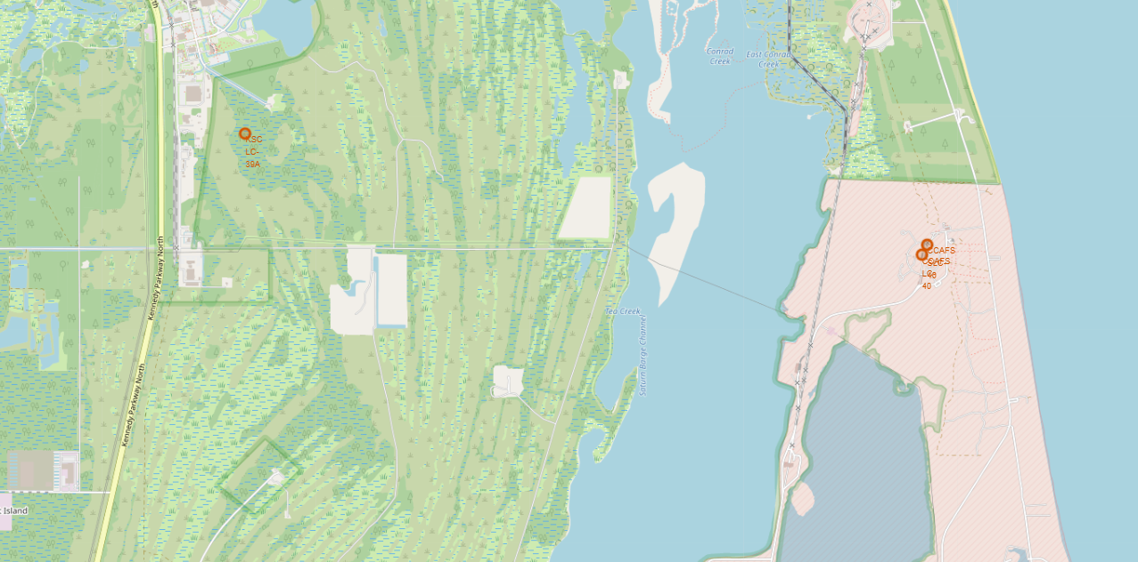
Launch Site Locations
The left map shows all launch sites relative US map. The right map shows the two Florida launch sites since they are very close to each other. All launch sites are near the ocean.

Slide 36
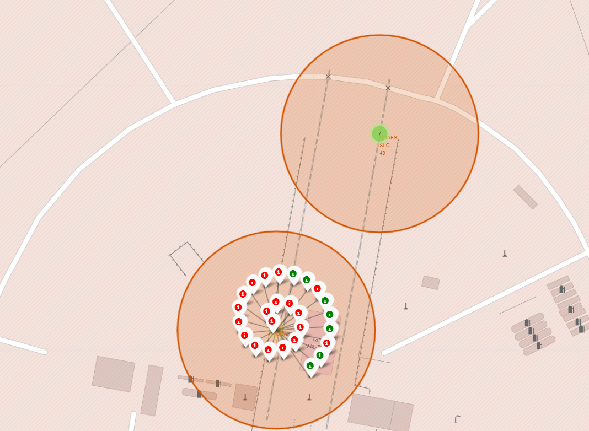
Colour-Coded Launch Markers
Clusters on the Folium map can be clicked on to display each successful landing (green icon) and failed landing (red icon). In this example, CCAFS LC 40 shows 7 successful landings and 19 failed landings.

Slide 37
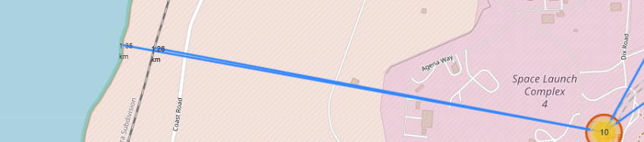
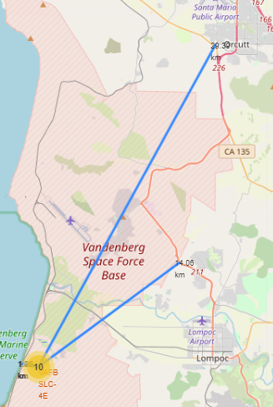
Key Location Proximities
Coast
Railway
City
Using KSC LC-39A as an example, launch sites are very close to railways for large parts and supply transportation. Launch sites are close to highways for human and supply transport. Launch sites are also close to coasts and relatively far from cities so that launch failures can land in the sea to avoid rockets falling in densely populated areas.
Highway

Slide 38

Section 4

Slide 39
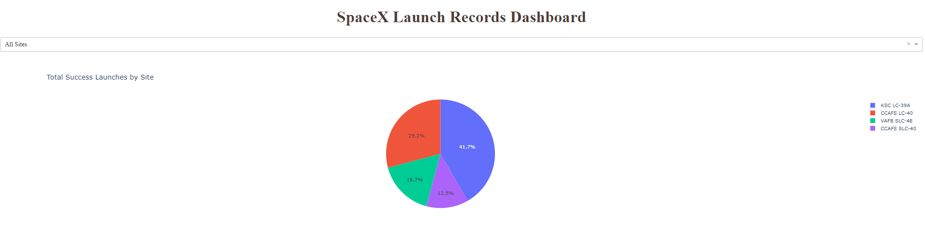
Successful Launches Across Launch Sites
This is the distribution of successful landings across all launch sites. CCAFS LC-40 is the old name of CCAFS SLC-40, so CCAFS and KSC have the same amount of successful landings, but a majority of the successful landings were performed before the name change. VAFB has the smallest share of successful landings. This may be due to the smaller sample and the increased difficulty of launching on the West Coast.

Slide 40
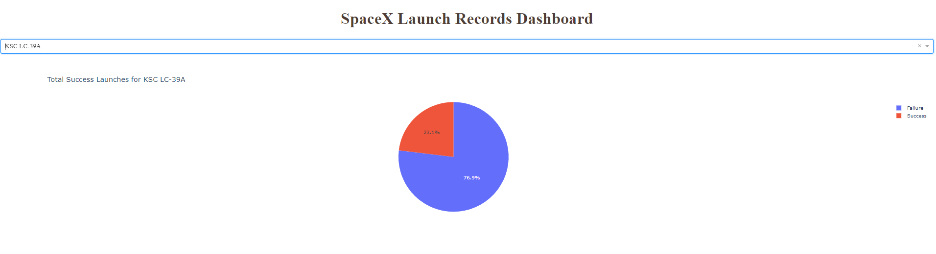
Highest Success Rate Launch Site
KSC LC-39A has the highest success rate with 10 successful landings and 3 failed landings

Slide 41
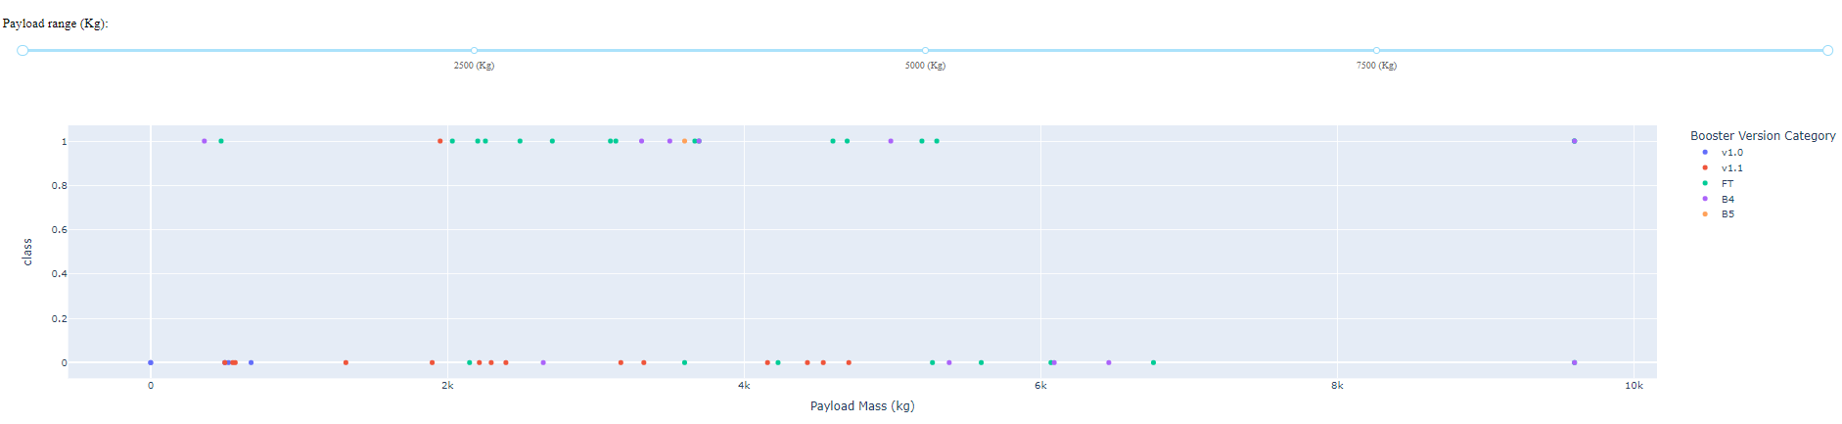
<Dashboard Screenshot 3>
Plotly dashboard has a Payload range selector. However, this is set from 0-10000 instead of the max Payload 15600. Class indicates 1 for successful landing and 0 for failure. The scatter plot also accounts for the booster version category in colour and the number of launches in point size. In this particular range of 0 to 6000, interestingly there are two failed landings with payloads of zero kg.

Slide 42

Section 5

Slide 43
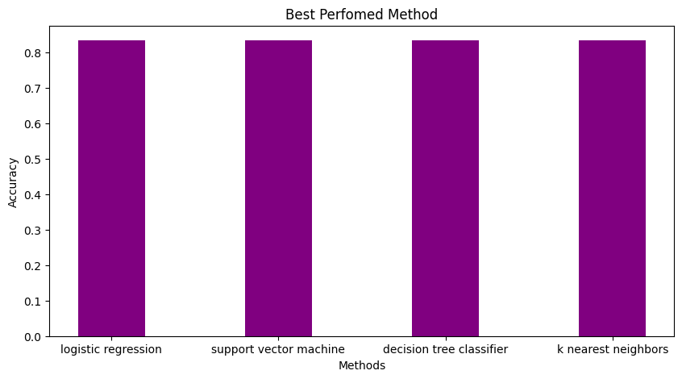
Classification Accuracy
All models had virtually the same accuracy on the test set at 83.33% accuracy. It should be noted that the test size is small at only a sample size of 18.
This can cause significant variance in accuracy results, such as those in Decision Tree Classifier model in repeated runs.
We likely need more data to determine the best model.

Slide 44

Confusion Matrix
Since all models performed the same for the test set, the confusion matrix is the same across all models. The models predicted 12 successful landings when the actual label was successful landing.
The models predicted 3 unsuccessful landings when the actual label was unsuccessful landing.
The models predicted 3 successful landings when the valid label was unsuccessful landings (false positives). Our models overpredict successful landings.

Slide 45
Conclusions
Our task: to develop a machine learning model for Space Y which wants to bid against SpaceX
The goal of the model is to predict when Stage 1 will successfully land to save ~$100 million USD
Used data from a public SpaceX API and web scraping SpaceX Wikipedia page
Created data labels and stored data in a DB2 SQL database
Created a dashboard for visualization
We created a machine-learning model with an accuracy of 83%
Allon Mask of SpaceY can use this model to predict with relatively high accuracy whether a launch will have a successful Stage 1 landing before launch to determine whether the launch should be made or not
If possible, more data should be collected to determine the best machine learning model better and improve accuracy

Slide 46
Appendix
SpaceX database CSV file link:
https://github.com/Harshit-Optimus0089/IBM_Data_Science_Capstone/blob/7ca0f11840aaf999e43eb1bbacd18eabc06ef633/Spacex.csv
GitHub Repository link:
https://github.com/Harshit-Optimus0089/IBM_Data_Science_Capstone

Slide 47


